Slide 1


Orientation Handbook
The Adams County
Sheriff’s Office
Supervised Release Program (SRP)

Slide 2
Why Are you here?
You were ordered to this program by a Judge, as a condition of your bond or summons. You will remain on this program as long as you are on bond/summons and have a future court date. Once you are sentenced, or a Judge removes SRP as a condition, you will no longer have to report to SRP.

Slide 3
Requirements
Telephone Check-In Calls
Random UA's
Office Visits
GPS

Slide 4
General Information
Name: Your Name
SRP Check In Number: 12345
Your Case Manager Is: Case Manager
Main Line Phone Number: 720-322-1390 ext. 5
Email: acsosrp@adcogov.org

Slide 5
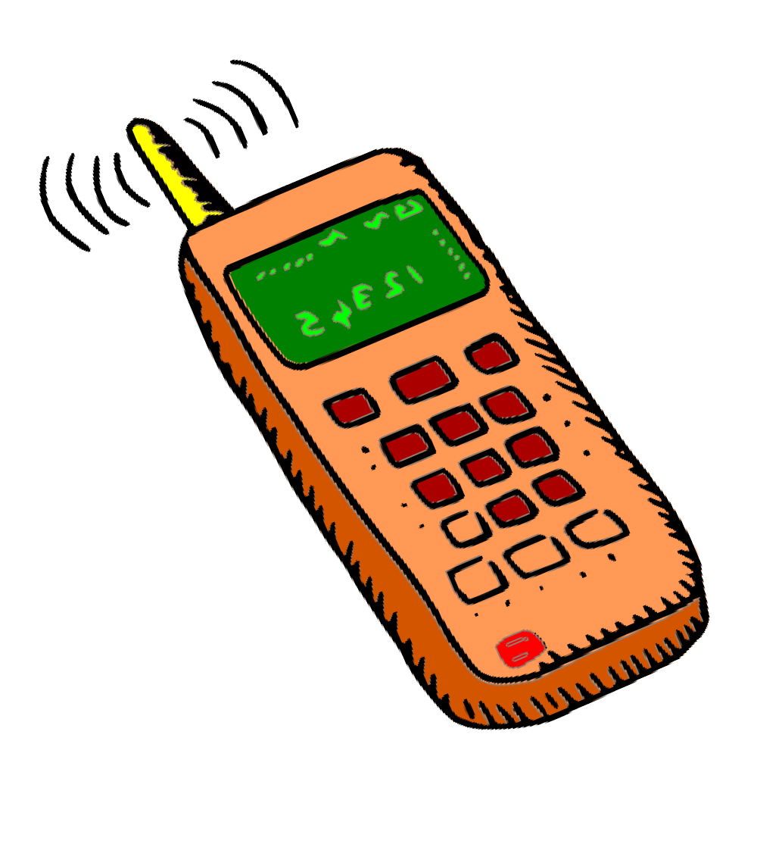
Telephone Check-in Calls
You have been assigned a day or days to check in with your assigned Case Manager. You can reach your Case Manager at the highlighted number. You can call between the hours of 12:01 am and 11:59 pm. If you missed calling in on your assigned day or days, please call the next day, as we would rather report to the Judge a late call rather than no call.- We will accept late calls only if it is on the following day.
You will get a voicemail when calling your Case Manager’s line. Please leave a message with your First and Last name, as well as your SRP Check-in Number and any contact changes you have. Those contact changes will include new phone number, address, or employment. Police contact is when an officer runs your name at traffic stop, park, home/party or any other location.

Slide 6
Check-In Calls Continued
If nothing has changed, please leave your First and Last name, and your SRP Check-in Number, and say “No changes, No police contact”, or “I’m checking in”. If you leave a voicemail, you will get checked in. You do not need to call back and see if the message was received. If you have a question, please leave the specific question in your message so when we call you back, we can give you an answer. However, if you need immediate help or clarity
please call our main line number.
Please remember: We have many people on the program who may have the same name, so it is important to leave your SRP Check-in Number. Also, your Case Manager may know who you are, but if someone else is checking their messages, this person may not know who you are. If we cannot understand your message, you will not get checked in. Speak slowly and clearly. Always call from the number given on your personal history form. You are under our supervision so you must clear your voicemails, so we are able to leave a message.

Slide 7

Check-In Calls Continued (2)
Again, make sure you are calling on your specific check in day or days. You have all day to do it. If you call the next day, it will be considered late, and we must report to the courts about late check in calls. However, a late check in call is better than a no check in call.
If your check-in day falls on a holiday, you still need to call and check-in.

Slide 8
Random UA's
Everyone has been assigned a UA ID number. Do not get this number confused with your SRP Check In Number. You must call 720-710-4359, every day, between 5:00 am and 5:59 pm.
You will not be able to access this line before 5:00 am
or after 5:59 pm. Once you enter your UA ID number, follow the prompts. The line will confirm the first three letters of your last name. It will then say, “You are required to test today” or “Do not test today”.
Your supervision plan will list your UA frequency. You will either test 2x a week or 2x per month.

Slide 9


UA's Continued
We have a contract with Intervention. Your UA ID Number is only valid at Intervention locations. The list of addresses is in the packet you were provided at orientation. If you submit your UA’s with Intervention, it will cost $24 for your UA. You should plan on bringing exact change.
You must take a picture a valid ID with you every time you submit a UA at Intervention. Please let us know if you do not have an ID so that we can upload your photo into their system. If you do not have an ID you can only go to Intervention locations.
The first time you submit a UA, fill out the form with Intervention staff and leave the form with them. This allows them to send us your UA results.

Slide 10
UAs Continued (2)
We DO NOT allow make-up UA's. You must submit your UA the day you are instructed to. We recommend calling the UA line first thing in the morning so you can plan your day to fit your UA in your schedule.
We cannot excuse UA's for any reason except for medical.
You will be excused if you provide hospital paperwork that includes an admit and discharge date and a doctor’s note that specifically states you are physically unable to do a UA.
You can request doing a UA through the hospital as well. It is unknown if it will cost extra.
For COVID we are not accepting at home COVID tests. You need to test at a
Doctor’s Office, Urgent Care, Walgreens, etc. and email us the results.
We DO NOT have vouchers. The UA fee is your responsibility. If
you cannot submit a UA because you can’t afford it, you should let your Case Manager and Public Defender know why you didn’t submit it. It will still count as a no show, but we will know why you weren’t able to submit it.

Slide 11
UA's Continued (3)
You may submit your UA's at any other testing facility. However, your UA ID Number is only valid at Intervention locations. If you submit at another location, you will tell them you are a walk-in client. It is then your responsibility to make sure those results are sent to your Case
Manager. They can be emailed to the email address provided on your paperwork by either yourself or the UA testing facility.
All UA'S must be a 9 panel UA with ETG testing included, must be observed, and they must be sent to a lab. You should also keep your Case Manager informed of where you submit your UA's. Keep in
mind, other locations may cost more money.
Your UA must be submitted by midnight the day you are instructed to
provide a UA. The only location open this late is ICCS Kendall, located in Lakewood. You need to be there by 11pm to have your UA
submitted by midnight.

Slide 12
Office Visits
Based on your supervision level you will be scheduled for an office visit before leaving today. Your supervision plan will specify what is required for you. If you need to reschedule or need to come in earlier/ later, you may call and speak with your Case Manager about this.
Office Hours:
We are here every day from 8am-7pm, including weekends and holidays. Doors remain open till 5pm. On weekends, we do not unlock the front door but are available by phone or appointment only.

Slide 13

GPS
1. GPS Clients are expected to follow all rules and expectations, or they will be considered non-compliant and a warrant could be sought for your arrest.
2. GPS Clients are responsible for maintaining their battery level on their GPS unit and will ensure the battery for the unit is charged and the unit does not reach low battery status.
3. Charging requirements are 1 full charge daily. Charge should take approximately 1-2 hours to complete, and not while sleeping-as the charging cord could come out of the unit or wall.
4. Failure to meet the charging requirements as stated above will result in a schedule requiring you to be at the office charging at a certain time for 2 hours daily and up to 5 days consecutively. Failure to follow that schedule can result in a warrant.
5. If a low battery alert is received, you must re-charge the battery immediately. Failure to do so could result in a warrant being sought for your arrest.
6. GPS Clients are required to come into the Office once a month to have the units inspected, and more often if needed.
7.GPS Clients are required to have a contact phone which can be answered 24 hours a day. If a GPS Client is contacted, they must answer or return the call within 30 minutes of receiving it. If the call is not returned a warrant will be issued for your arrest. If you have a voicemail, it must be set up and not full of messages.

Slide 14
GPS Continued
8. For GPS issues occurring between the hours of 7:00pm and 8:00am please contact the on-call phone at 720-697-4772. Text messages are unacceptable.
9. If you are notified to contact your Case Manager via your GPS unit you must call either the SRP main line (720)-322-1390 or the on-call line listed above depending on the time you are notified. Failure to do so may result in a warrant.
10. If you are aware of your exclusion zones you must always stay away from them unless a civil standby is coordinated through the local law enforcement agency. You must advise SRP prior to starting your civil assist. SRP can be reached at 720-322-1390 or after hours at 720-697-4772.
11. If you are going in an area which may affect the ability of the GPS unit to track your location, (Mountains, Airplane, anywhere there is no cell service) you must notify your Case Manager immediately and make arrangements to be able to be contacted/tracked. This may require you leaving the area at periods of time to get a trace on your unit.
12. If you are granted permission to leave the State, or travel in State, (SRP will require an itinerary of your travels) and have GPS unit issues, you will be responsible to return as quickly as able to SRP/Jail and stay in continual contact with your Case Manager until you have had the unit checked or replaced.
13. When charging the unit, only the charging cable issued will be allowed. No after-market charging devices for the automobile or unit are allowed due to damaging the internal hardware, and no charging into an extension cord as the results are the same.

Slide 15

Court
Your next court is at the bottom of your paperwork. Prior to your court date a Compliance Letter will be sent to the Judge, DA, and Public Defender. This report only states the facts: We document if you called late/missed any Check-in Calls, missed any UA's, and if any UA’s were returned positive, and for what drugs. If you hire a Private Attorney, they will have access through the courts to this report as well.

Slide 16
Terms and Conditions
1. The defendant shall contact the Supervised Release Office as instructed.
    This is calling on your assigned day or days to check in with your Case Manager.
Calling SRP within 24 hours of release.
GPS client’s if something happens to their GPS or for
emergencies.
2. The defendant is restrained from harassing, molesting, or intimidating any witness or victim in this case.

Slide 17
3. The defendant shall not contact the victim unless it’s approved by the court.
If you have a protection order that has been modified, we recommend keeping a paper copy with you in case it doesn’t get updated in the system.
4. The defendant shall appear at all court hearings.
If you forget your court date or lose your paperwork, you can call us, we can look your court date up for you.
If you miss your court date, the Judge will automatically issue a Bench Warrant for your Failure to Appear.

Slide 18
5. The defendant shall not violate any Federal, State, or Municipal laws while on supervision.
If you have police contact, we will be notified. You need to call and
report it to your Case Manager and let us know what happened.
New law violations are a direct violation of the SRP Program and a warrant will be issued.
6. The defendant shall establish a residence and if any changes in residence , employment , and/ or contact phone number occur, the defendant shall notify the Supervised Release Office.
  You were released on bond and required to be supervised; we can not supervise you if we can not contact you. If you are not complying with the program, we will try to contact you to help you get in compliance. If you changed your phone number and didn’t tell us, or if your phone was disconnected, we are unable to supervise you as we can not make contact. At this point our only option is to request that your bond be revoked.
  Always make sure your Case Manager knows how to get in contact with you!

Slide 19
7. The defendant shall participate in all programs ordered by the court.
That includes this program and anything else the courts may
have ordered: Probation, Parole, Court ordered classes, etc.
The defendant will not use controlled substances, dangerous or abusable drugs without a prescription.
  This includes alcohol and marijuana. If your first UA is positive for marijuana, the levels need to decrease with each UA. If you are on prescription medication that may show up in your UA or have a valid Medical Marijuana Card, we will need to provide a copy of the Medical Card and pictures of the pill bottle. You can email or bring this paperwork to the office. If you have a protection order, keep in mind that also prohibits you from using drugs or alcohol.

Slide 20
9. The defendant will submit to drug testing as instructed by the Supervised Release Staff.
This is calling the UA line daily and submitting your UA as instructed.

Slide 21



Out of State Travel
If you have a class 1 felony charge you need permission from the Judge.
Your bond/protection order cannot specifically state you cannot
travel out of state.
Email us all your travel plans; where you are going and for how long and what your plan is for your UA’s/GPS.
For out of country travel you need permission from the Court to be excused from UA’s over the time you will be out of the country.

Slide 22

QUESTIONS?

